Slide 1
Loops
Loops in Java are similar to those in other high-level languages
Java has three types of loop statements: the while, the do-while, and the for statements
The code that is repeated in a loop is called the body of the
loop
Each repetition of the loop body is called an iteration of the loop

Slide 2
while statement
A while statement is used to repeat a portion of code (i.e., the loop body) based on the evaluation of a Boolean expression
The Boolean expression is checked before the loop body is executed
When false, the loop body is not executed at all
Before the execution of each following iteration of the loop body, the
Boolean expression is checked again
If true, the loop body is executed again
If false, the loop statement ends
The loop body can consist of a single statement, or multiple statements enclosed in a pair of braces ({ })

Slide 3
while Syntax
while (Boolean_Expression) Statement
Or
while (Boolean_Expression)
{
Statement_1
Statement_2
Statement_Last
}
. . .

Slide 4
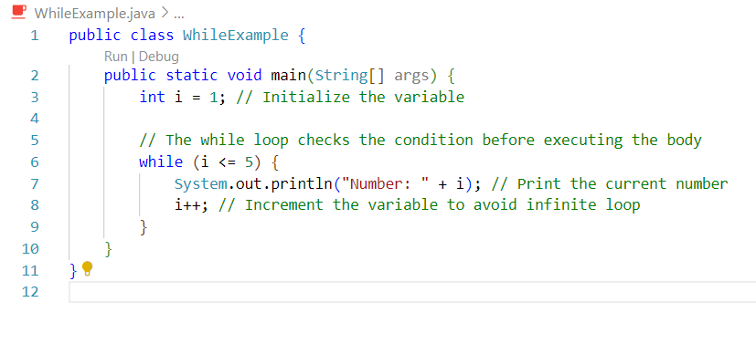
Example 1

Slide 5
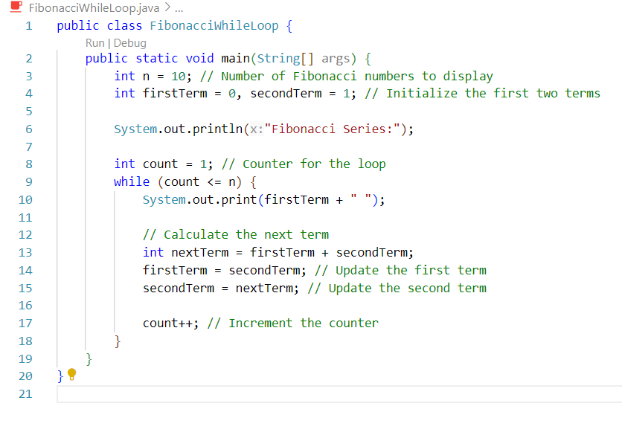
Example 2

Slide 6
do-while Statement
A do-while statement is used to execute a portion of code (i.e., the loop body), and then repeat it based on the evaluation of a Boolean expression
The loop body is executed at least once
The Boolean expression is checked after the loop body is executed
The Boolean expression is checked after each iteration of the loop
body
If true, the loop body is executed again
If false, the loop statement ends
Don't forget to put a semicolon after the Boolean expression
Like the while statement, the loop body can consist of a single statement, or multiple statements enclosed in a pair of braces ({ })

Slide 7
do-while Syntax
do
Statement
while (Boolean_Expression);
Or
do
{
Statement_1 Statement_2
Statement_Last
} while (Boolean_Expression);
. . .

Slide 8
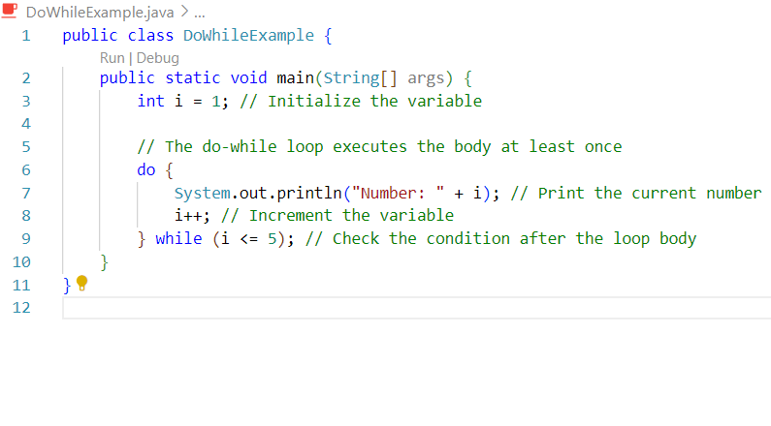
Example

Slide 9
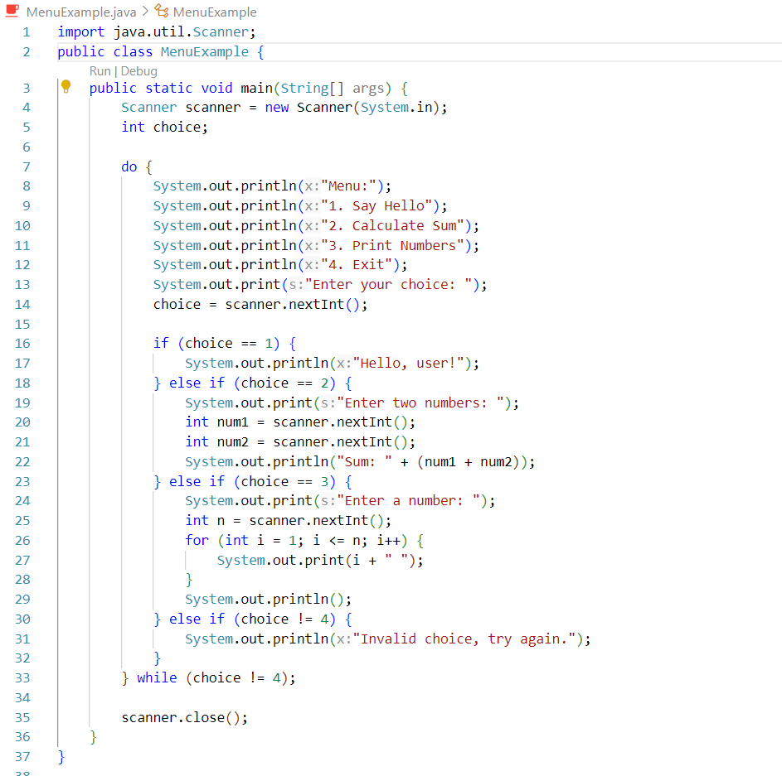
Example

Slide 10
Equivalence of while and do-while loop
Given the following structure for a do-while loop:
do
{
Statements;
} while (Boolean condition);
The equivalent while loop is:
Statements;
while (Boolean condition)
{
Statements;
}

Slide 11
Equivalence of do-while and while loop
Given the following structure for a while loop:
while (Boolean condition)
{
Statements;
}
The equivalent do-while loop is:
if (Boolean condition)
{
do
{
Statements;
} while (Boolean condition);
}

Slide 12
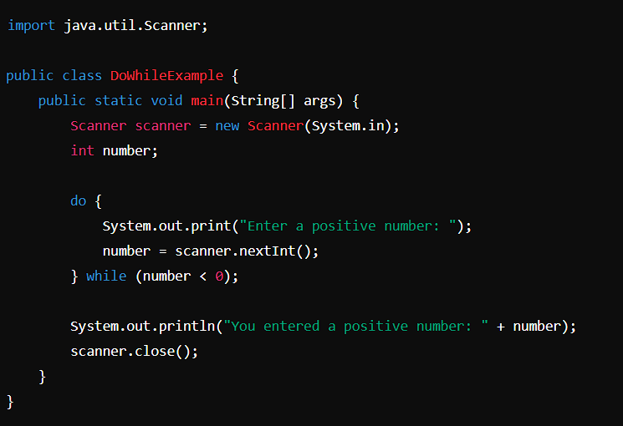
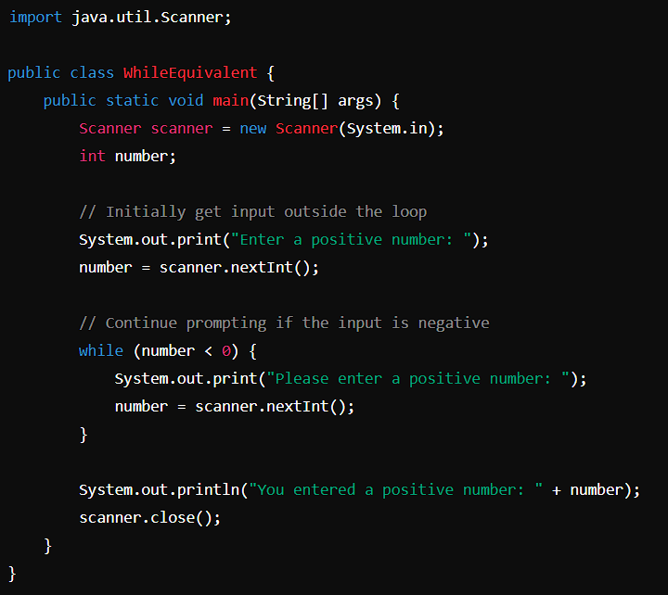
Example

Slide 13
Algorithms and Pseudocode
The hard part of solving a problem with a computer program is not dealing
with the syntax rules of a programming language
Rather, coming up with the underlying solution method is the most difficult part
An algorithm is a set of precise instructions that lead to a solution
An algorithm is normally written in pseudocode, which is a mixture of programming language and a human language, like English
Pseudocode must be precise and clear enough so that a good programmer can
convert it to syntactically correct code
However, pseudocode is much less rigid than code: One needn't worry about the fine points of syntax or declaring variables, for example

Slide 14
The for Statement
The for statement is most commonly used to step through an integer variable in equal increments
It begins with the keyword for, followed by three expressions in parentheses that describe what to do with one or more controlling variables
The first expression tells how the control variable or variables are
initialized or declared and initialized before the first iteration
The second expression determines when the loop should end, based on the evaluation of a Boolean expression before each iteration
The third expression tells how the control variable or variables are
updated after each iteration of the loop body

Slide 15
The for Statement Syntax
for (Initializing; Boolean_Expression; Update)
Body
The Body may consist of a single statement or a list of statements enclosed in a pair of braces ({ })
Note that the three control expressions are separated by two,
not three, semicolons
Note that there is no semicolon after the closing parenthesis at the beginning of the loop

Slide 16
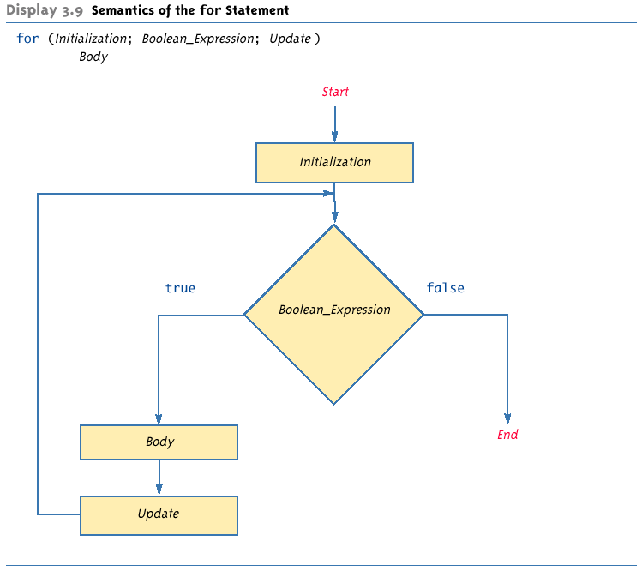
Semantics of the for Statement

Slide 17
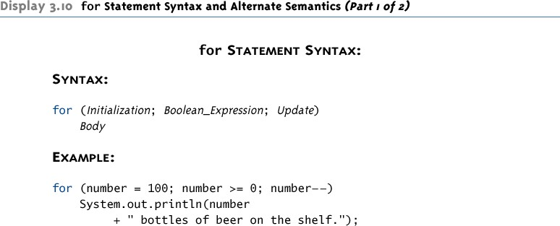
for Statement Syntax and Alternate Semantics

Slide 18
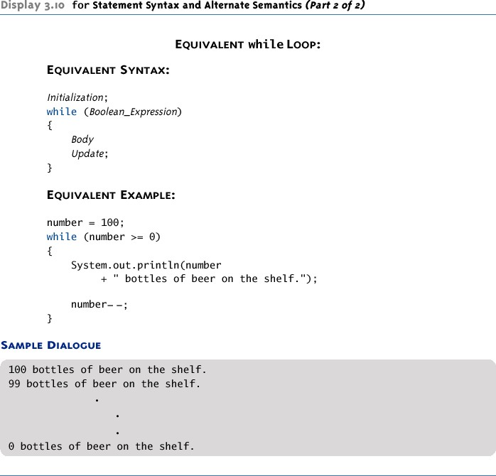
for Statement Syntax and Alternate Semantics

Slide 19
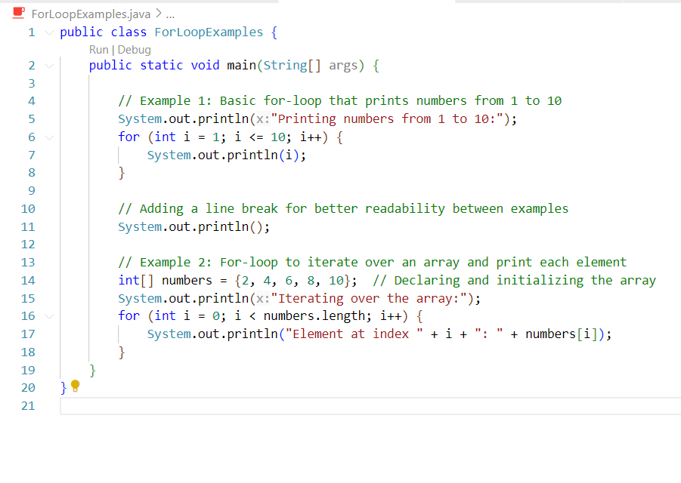
Examples

Slide 20
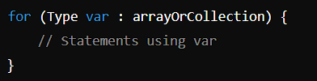
For Each Loop
The for-each loop in Java, also known as the "enhanced for loop", was introduced in Java 5 to simplify iteration over collections (like arrays and other iterable objects). It is primarily used to traverse through elements in arrays or iterable collections such as List, without needing to use an index variable to access elements.
Syntax of the for-each loop:
Where:
Type is the data type of the elements in the array or collection.
var is the variable that iterates over each element of the array or collection.
arrayOrCollection is the array or collection that you want to loop through.
Benefits of the for-each loop:
Simplicity: Eliminates the possibility of programming errors, such as off-by-one errors, and makes the code easier to read.
Safety: Eliminates the risk of accessing invalid indices since the loop implicitly handles the indexing.

Slide 21
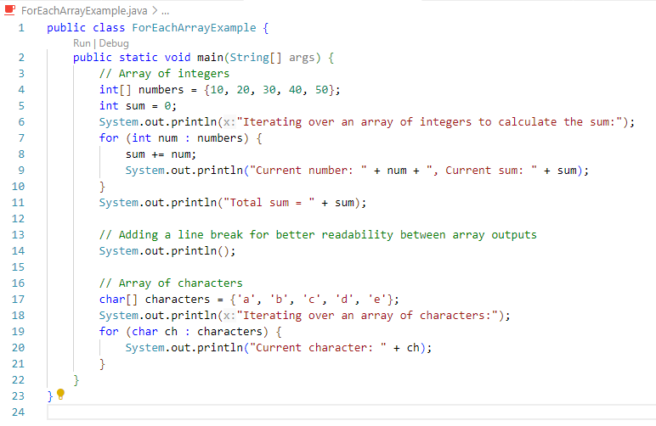
Example

Slide 22
The Comma in for Statements
A for loop can contain multiple initialization actions separated with commas
Caution must be used when combining a declaration with multiple actions
It is illegal to combine multiple type declarations with multiple actions, for example
To avoid possible problems, it is best to declare all variables outside the for statement
A for loop can contain multiple update actions, separated with commas, also
It is even possible to eliminate the loop body in this way
However, a for loop can contain only one Boolean
expression to test for ending the loop

Slide 23
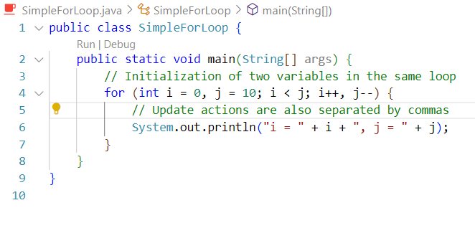
Multiple Initialization

Slide 24
Infinite Loops
A while, do-while, or for loop should be designed so that the value tested in the Boolean expression is changed in a way that eventually makes it false, and terminates the loop
If the Boolean expression remains true, then the loop will run forever, resulting in an infinite loop
– Loops that check for equality or inequality (== or !=) are especially prone to this error and should be avoided if possible

Slide 25
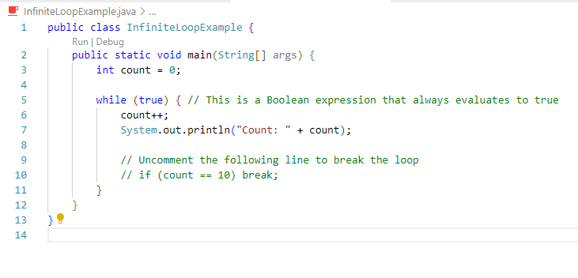
Infinite Loops Example

Slide 26
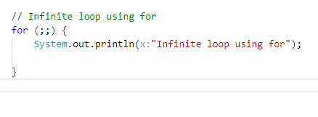
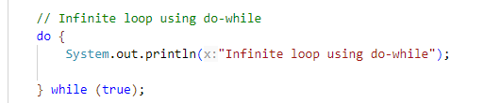
Infinite Loops Example

Slide 27
Nested Loops
Loops can be nested, just like other Java structures
– When nested, the inner loop iterates from beginning to end for each
single iteration of the outer loop
int rowNum, columnNum;
for (rowNum = 1; rowNum <=3; rowNum++)
{
for (columnNum = 1; columnNum <=2;
columnNum++) System.out.print(" row " + rowNum +
" column " + columnNum);
System.out.println();
}

Slide 28
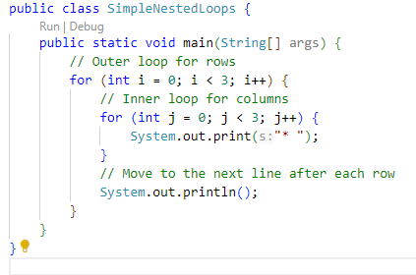

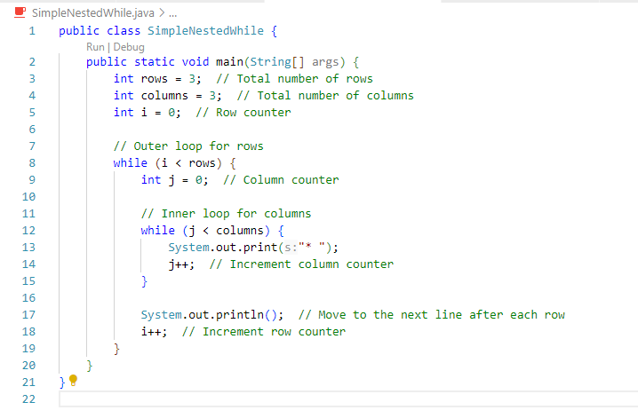

Nested Loops

Slide 29
The break and continue Statements
The break statement consists of the keyword break
followed by a semicolon
When executed, the break statement ends the nearest enclosing switch or loop statement
The continue statement consists of the keyword
continue followed by a semicolon
When executed, the continue statement ends the current
loop body iteration of the nearest enclosing loop statement
Note that in a for loop, the continue statement transfers control to the update expression
When loop statements are nested, remember that any break or continue statement applies to the innermost, containing loop statement

Slide 30
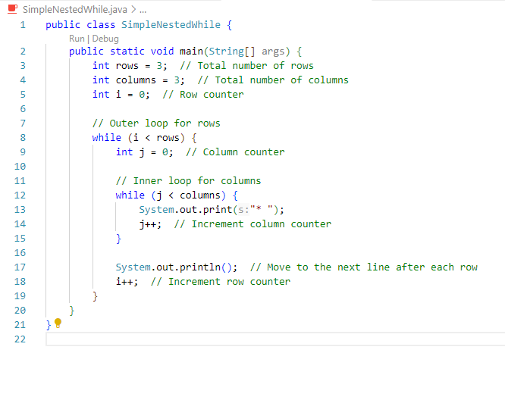
Example

Slide 31
The Labeled break Statement
There is a type of break statement that, when used in nested loops, can end any containing loop, not just the innermost loop
If an enclosing loop statement is labeled with an Identifier, then the following version of the break statement will exit the labeled loop, even if it is not the innermost enclosing loop:
break someIdentifier;
To label a loop, simply precede it with an Identifier and a colon:
someIdentifier:

Slide 32
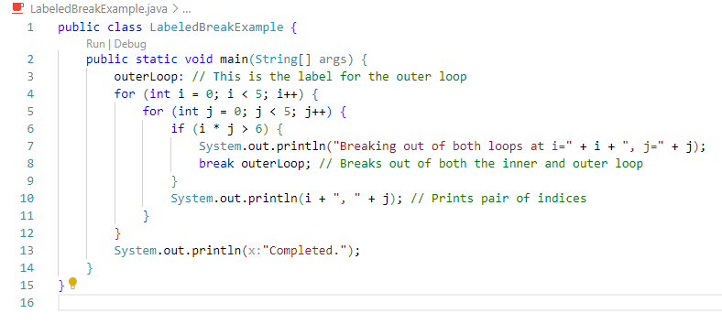
Example

Slide 33
The exit Statement
A break statement will end a loop or switch statement, but will not end the program
The exit statement will immediately end the program as soon as it is invoked: System.exit(0);
The exit statement takes one integer argument
– By tradition, a zero argument is used to indicate a normal ending of the program

Slide 34
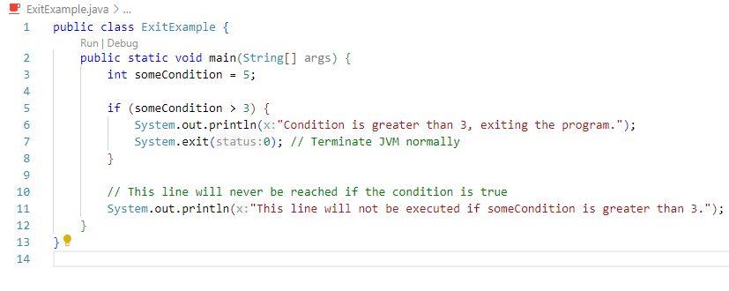
Example

Slide 35
Loop Bugs
The two most common kinds of loop errors are unintended infinite loops and off-by-one errors
An off-by-one error is when a loop repeats the loop body one too many or one too few times
This usually results from a carelessly designed Boolean test
expression
Use of == in the controlling Boolean expression can lead to an infinite loop or an off-by-one error
This sort of testing works only for characters and integers, and should never be used for floating-point

Slide 36
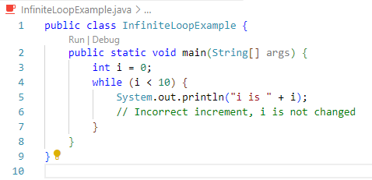
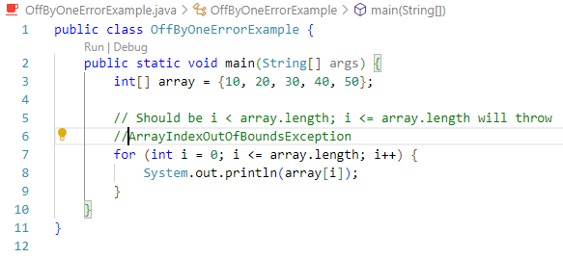
Loop Bugs Example
Infinite Loop Example
Off-by-One Error Example

Slide 37
Tracing Variables
Tracing variables involves watching one or more variables change value while a program is running
This can make it easier to discover errors in a program and debug them
Many IDEs (Integrated Development Environments) have a built-in utility that allows variables to be traced without making any changes to the program
Another way to trace variables is to simply insert temporary output statements in a program
System.out.println("n = " + n); // Tracing n
– When the error is found and corrected, the trace statements can
simply be commented out

Slide 38
General Debugging Techniques
Examine the system as a whole – don’t assume the
bug occurs in one particular place
Try different test cases and check the input values
Comment out blocks of code to narrow down the offending code
Check common pitfalls
Take a break and come back later
DO NOT make random changes just hoping that the change will fix the problem!

Slide 39
Debugging Example (1 of 9)
The following code is supposed to present a menu and get user input until either ‘a’ or ‘b’ is entered.
String s = ""; char c = ' ';
Scanner keyboard = new Scanner(System.in);
do
{
System.out.println("Enter 'A' for option A or 'B' for option B."); s = keyboard.next();
s.toLowerCase();
c = s.substring(0,1);
}
while ((c != 'a') || (c != 'b'));

Slide 40
Debugging Example (2 of 9)
Result: Syntax error:
c = s.substring(0,1); : incompatible types found: java.lang.String
required: char
Using the “random change” debugging technique we might try to change the data type of c to String, to make the types match
This results in more errors since the rest of the code treats c like a char

Slide 41
Debugging Example (3 of 9)
First problem: substring returns a String, use charAt to get the first character:
String s = ""; char c = ' ';
Scanner keyboard = new Scanner(System.in);
do
{
System.out.println("Enter 'A' for option A or 'B' for option B."); s = keyboard.next();
s.toLowerCase();
c = s.charAt(0);
}
while ((c != 'a') || (c != 'b'));
Now the program compiles, but it is stuck in an infinite loop.
Employ tracing:

Slide 42
Debugging Example (4 of 9)
do
{
System.out.println("Enter 'A' for option A or 'B' for option B.");
s = keyboard.next(); System.out.println("String s = " + s); s.toLowerCase(); System.out.println("Lowercase s = " + s); c = s.charAt(0);
System.out.println("c = " + c);
}
while ((c != 'a') || (c != 'b'));
Sample output:
Enter 'A' for option A or 'B' for option B. A
String s = A Lowercase s = A c = A
Enter 'A' for option A or 'B' for option B.
From tracing we can see that the string is never changed to lowercase. Reassign the lowercase string back to s.

Slide 43
Debugging Example (5 of 9)
The following code is supposed to present a menu and get user input until either ‘a’ or ‘b’ is entered.
do
{
System.out.println("Enter 'A' for option A or 'B' for option B.");
s = keyboard.next(); s = s.toLowerCase(); c = s.charAt(0);
}
while ((c != 'a') || (c != 'b'));
However, it’s still stuck in an infinite loop. What to try next?

Slide 44
Debugging Example (6 of 9)
Could try the following “patch”
do
{
System.out.println("Enter 'A' for option A or 'B' for option B."); s = keyboard.next();
s = s.toLowerCase(); c = s.charAt(0);
if ( c == 'a')
break;
if (c == 'b')
break;
}
while ((c != 'a') || (c != 'b'));
This works, but it is ugly! Considered a coding atrocity, it doesn’t fix the underlying problem. The boolean condition after the while loop has also become meaningless. Try more tracing:

Slide 45
Debugging Example (7 of 9)
do
{
System.out.println("Enter 'A' for option A or 'B' for option B.");
s = keyboard.next(); s = s.toLowerCase(); c = s.charAt(0);
System.out.println("c != 'a' is " + (c != 'a'));
System.out.println("c != 'b' is " + (c != 'b'));
System.out.println("(c != 'a') || (c != 'b')) is "
+ ((c != 'a') || (c != 'b')));
}
while ((c != 'a') || (c != 'b'));
Sample output:
Enter 'A' for option A or 'B' for option B. A
c != 'a' is false c != 'b' is true
(c != 'a') || (c != 'b')) is true
From the trace we can see that the loop’s boolean expression is true because c
cannot be not equal to ‘a’ and not equal to ‘b’ at the same time.

Slide 46
Debugging Example (8 of 9)
Fix: We use && instead of ||
do
{
System.out.println("Enter 'A' for option A or 'B' for option B."); s = keyboard.next();
s = s.toLowerCase(); c = s.charAt(0);
}
while ((c != 'a') && (c != 'b'));

Slide 47
Debugging Example (9 of 9)
Even better: Declare a boolean variable to control the do-while loop. This makes it clear when the loop exits if we pick a meaningful variable name.
boolean invalidKey; do
{
System.out.println("Enter 'A' for option A or 'B' for option B.");
s = keyboard.next(); s = s.toLowerCase(); c = s.charAt(0);
if (c == 'a')
invalidKey = false; else if (c == 'b')
invalidKey = false;
else
invalidKey = true;
}
while (invalidKey);

Slide 48
Assertion Checks
An assertion is a sentence that says (asserts) something about the state of a program
An assertion must be either true or false, and should be true if a program is working properly
Assertions can be placed in a program as comments
Java has a statement that can check if an assertion is true
assert Boolean_Expression;
If assertion checking is turned on and the Boolean_Expression evaluates to false, the program ends, and outputs an assertion failed error message
Otherwise, the program finishes execution normally

Slide 49
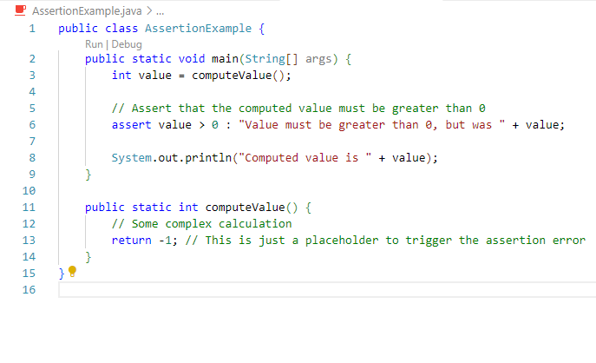
Example

Slide 50
Assertion Checks
A program or other class containing assertions is compiled in the usual way
After compilation, a program can run with assertion checking turned on or turned off
– Normally a program runs with assertion checking turned off
In order to run a program with assertion checking turned on, use the following command (using the actual ProgramName):
java –enableassertions ProgramName

Slide 51
Preventive Coding
Incremental Development
Write a little bit of code at a time and test it before moving on
Code Review
Have others look at your code
Pair Programming
Programming in a team, one typing while the other watches, and periodically switch roles

Slide 52
Generating Random Numbers
The Random class can be used to generate pseudo-random numbers
– Not truly random, but uniform distribution based on a mathematical function and good enough in most cases
Add the following import
import java.util.Random;
Create an object of type Random
Random rnd = new Random();

Slide 53
Generating Random Numbers
To generate random numbers use the nextInt() method to get a random number from 0 to n-1
int i = rnd.nextInt(10);
// Random number from 0 to 9
Use the nextDouble() method to get a random number from 0 to 1 (always less than 1)
double d = rnd.nextDouble(); // d is >=0 and < 1

Slide 54
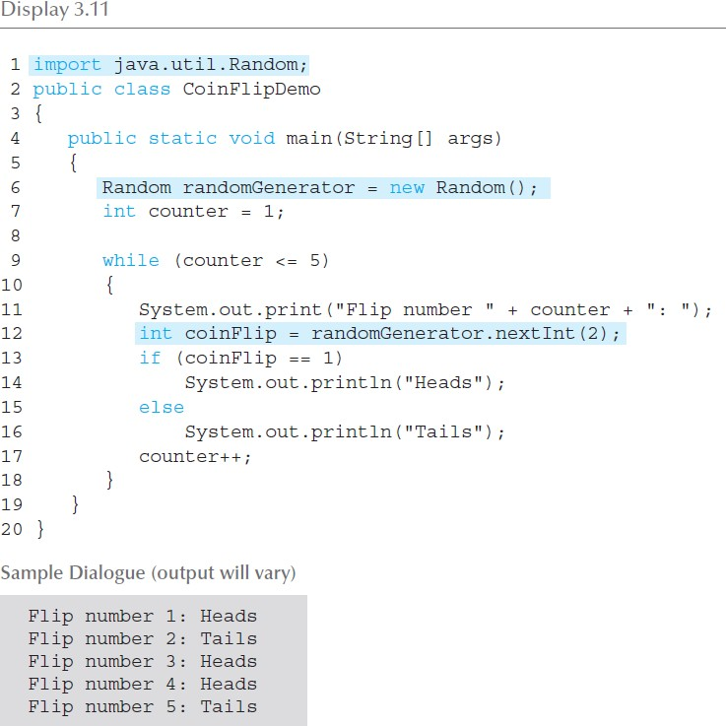
Simulating a Coin Flip

